Slide 1
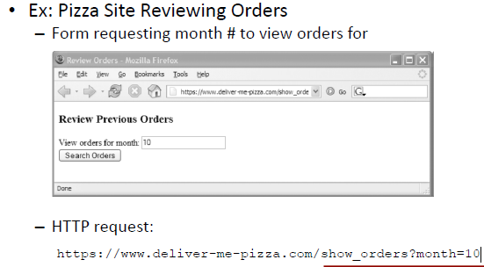
Sql Injection Example

Slide 2
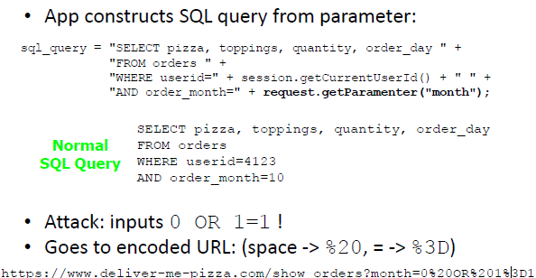

Slide 3
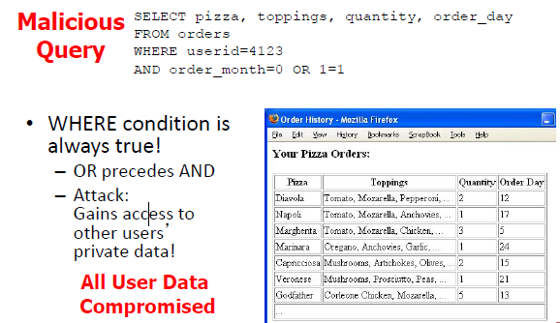

Slide 4
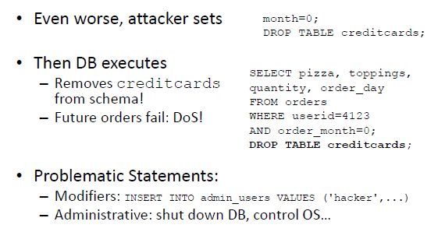

Slide 5
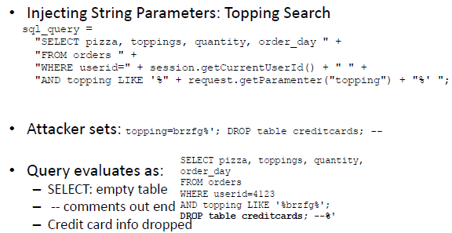

Slide 6
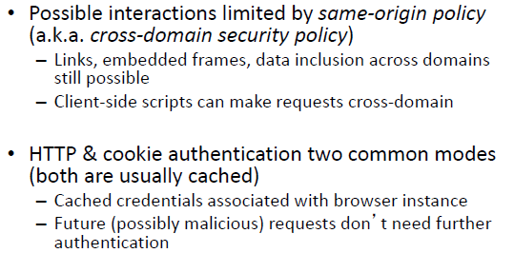
XSS

Slide 7
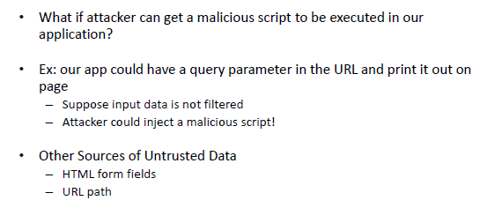

Slide 8
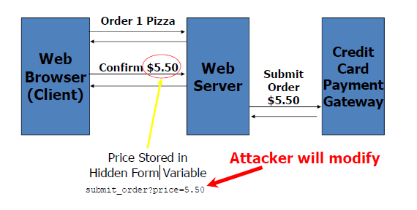

Slide 9
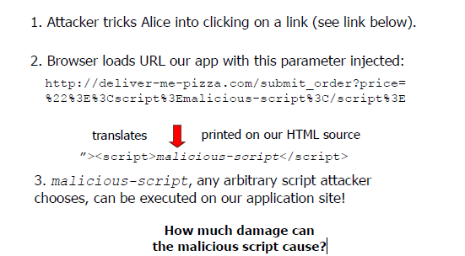

Slide 10
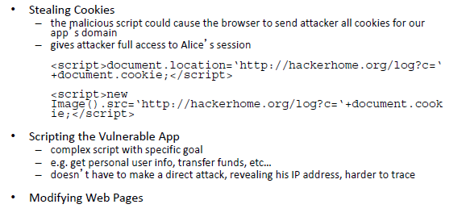

Slide 11
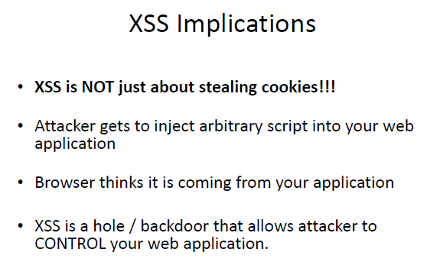

Slide 12
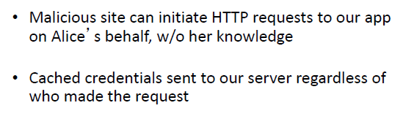
CSRF (Cross Site Request Forgery)

Slide 13
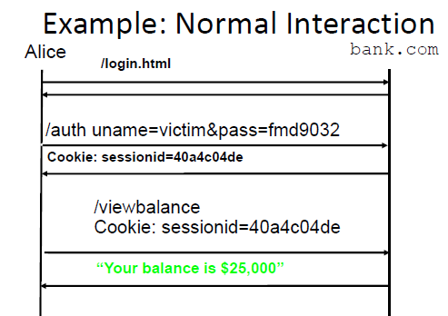

Slide 14
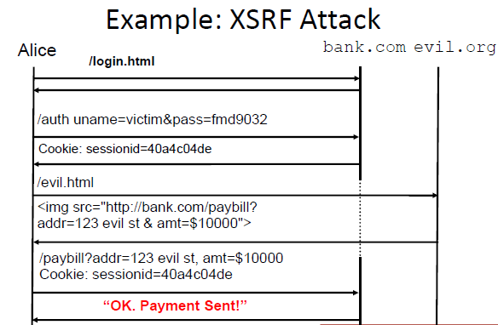

Slide 15
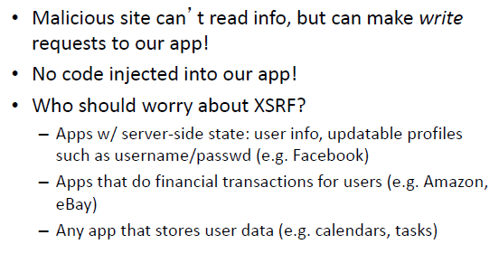
XSRF Impacts

Slide 16
CSRF
A CSRF attack targets Web applications failing to differentiate between valid requests and forged requests controlled by attacker
let’s say that Bob has an online banking account on samplebank.com. He regularly visits this site to conduct transactions with his friend Alice. Bob is unaware that samplebank.com is vulnerable to CSRF attacks. Meanwhile, an attacker aims to transfer $5,000 from Bob’s account by exploiting this vulnerability. To successfully launch this attack:
The attacker must build an exploit URL.
The attacker must also trick Bob into clicking the exploit URL.
Bob needs to have an active session with samplebank.com.

Slide 17

Using various social engineering attack methods, an attacker can trick Bob into loading the malicious URL. This can be achieved in various ways.
1.including malicious HTML image elements onto forms,
2.placing a malicious URL on pages that are often accessed by users while logged into the application
3.By sending a malicious URL through email.
Consider the scenario that includes an image tag in an attacker-crafted email to Bob. Upon receiving it, Bob’s browser application opens this URL automatically—without human intervention. As a result, without Bob’s permission, a malicious request is sent to the online banking application. If Bob has an active session with samplebank.com, the application would treat this as an authorized amount transfer request coming from Bob. It would then transfer the amount to the account specified by an attacker.

Slide 18
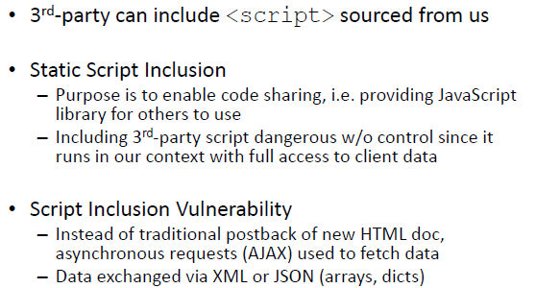
XSSI (Cross Site Script Inclusion)

